Slide 1
Comparative literature
Faculty of Arts
Year 2
Shaymaa A. Shahine

Slide 2
Codes of Conduct
Phones are not allowed
Start 10.30 to 12 p.m.
Doors closes 10.40
Inside CLASS, you are allowed to drink water, eat what you have, go to Toilet, go out to use your phone (PLEASE DON’T CAUSE DISTURBANCE)
What is in it for you? Listening, Reading and Critical thinking
Volunteers for Reflection Tree
Volunteers for Question Bank

Slide 3
A word is born

Slide 4
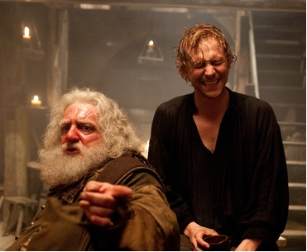
The word 'comparative' derived from Latin comparativus, from comparare
comparative as an adjective was firstly used by Shakespeare in his play King Henry IV, Part I
In 1597
Falstaff's uttered to Hal, Prince of Wales: “…the most comparative, rascalliest, sweet young prince."

Slide 5
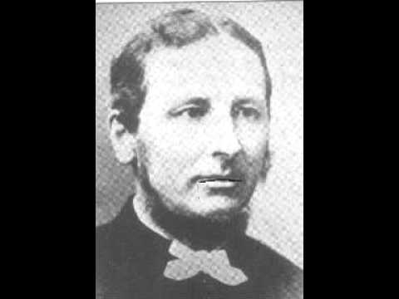
In 1598
Francis Meres used the term as adjective in the section titled "A Comparative Discourse of Our English Poets with the Greek, Latin and Italian Poets
it is the first article of studies of comparative literature. Then

